Slide 1
Effects of Values and Committed Action on Program Compliance on an Individual with Traumatic Brain Injury
Jeffrey Oliver, USF
Jonathan Jaberg, NeuroRestorative
Deb Westurlund, NeuroRestorative,
Timothy Weil, USF

Slide 2
What’s Important with Brain Injury and how are you going to get there?

Slide 3
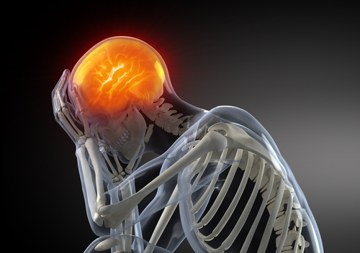

Slide 4
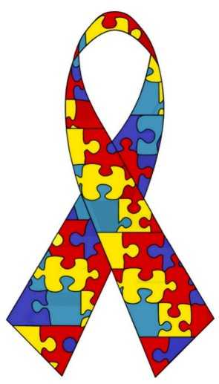
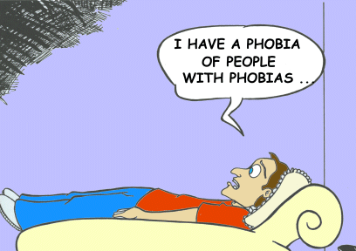
Behavior Analysts and Values

Slide 5
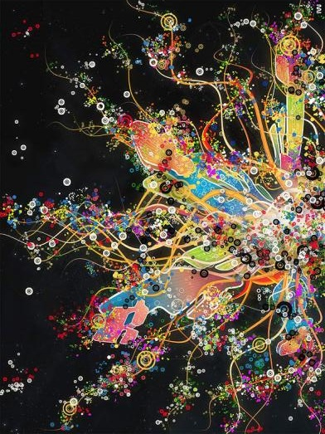

Slide 6
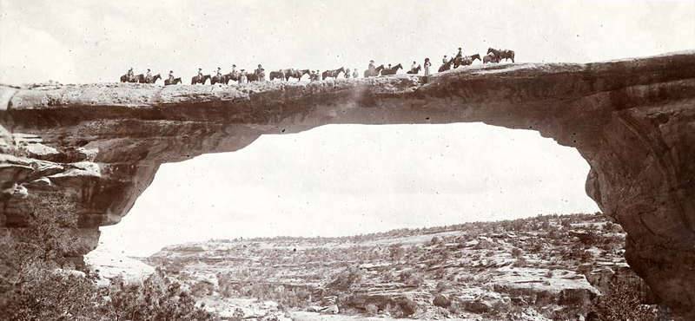
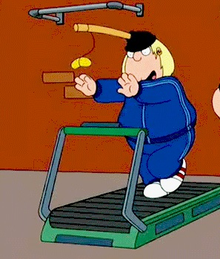
Behavior Analysts and Values
Values = Behavior

Slide 7
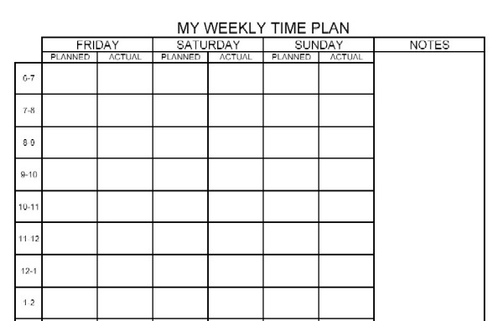
Spoiler
Method
Shower
√
Breakfast
√
Work
X
Work
X
Therapy
X
Lunch
√
Therapy
X

Slide 8
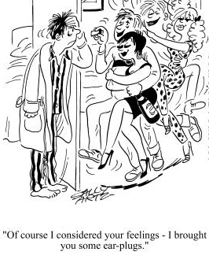
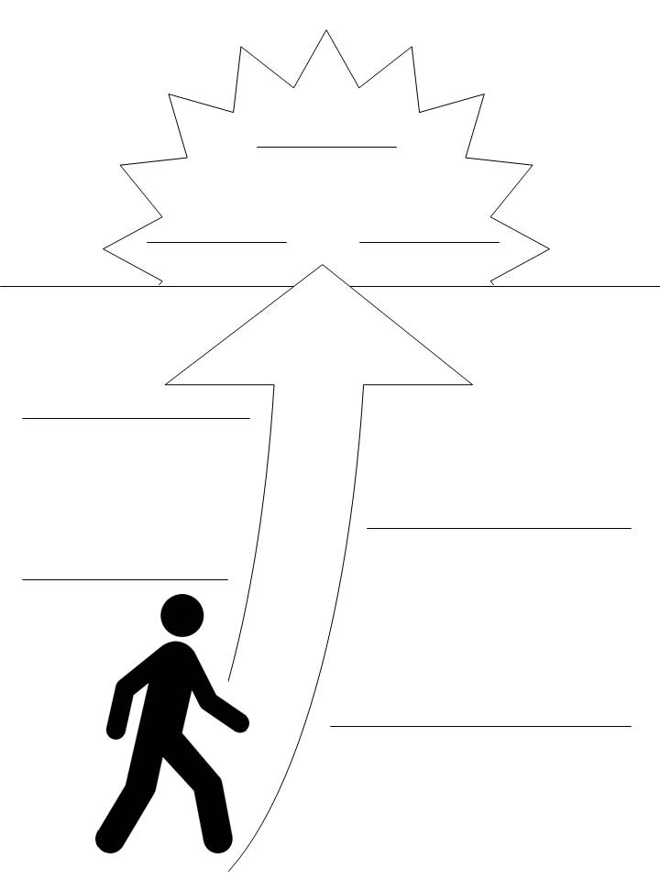
Method
Intervention

Slide 9
Baseline
Values
Activities
Day

Slide 10
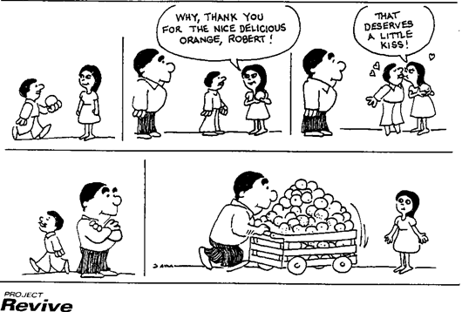
Discussion
What Happened?
Activities ≠ Values

Slide 11
Discussion
Values

Slide 12
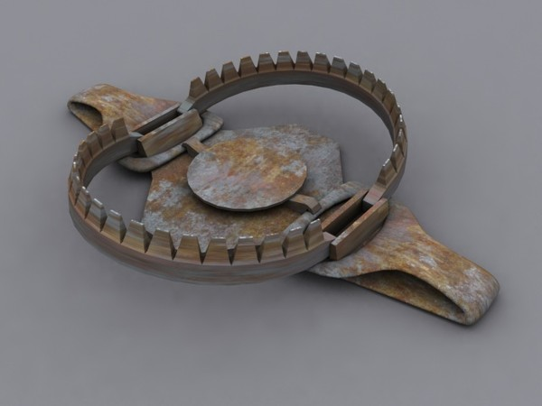
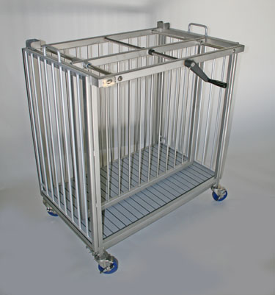
Discussion
Other Verbal Behavior

Slide 13
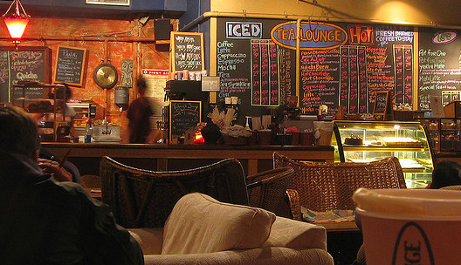
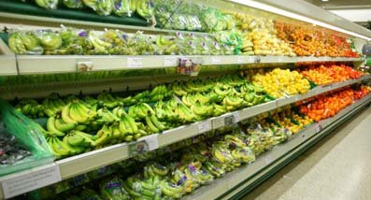
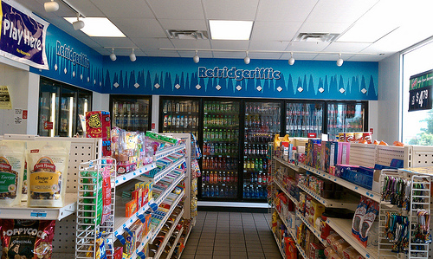
What Now?
Transition to Independent Living Checklist

Slide 14
Thank You
jroliver@mail.usf.edu

